Slide 1
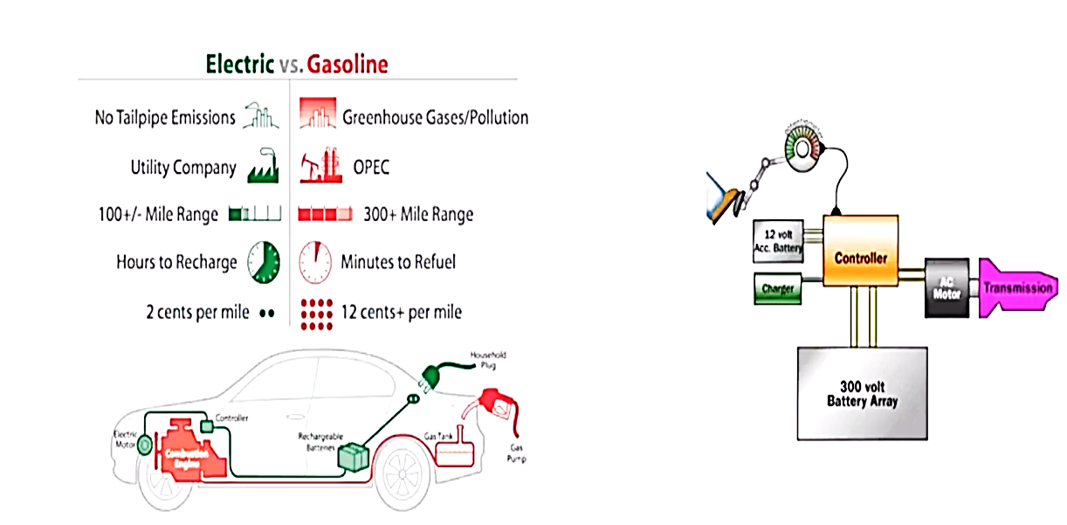
Electric VS. Gasoline

